Slide 1
CH 4: Select Your Topic, Purpose, & Thesis
Brandon Straight

Slide 2

Your Topic
Substantive- is it worth the time and attention
Appropriate to YOU as a speaker
Appropriate to your audience
Culturally sensitive

Slide 3
How to find a topic
Yourself- what are your interests?
Brainstorm with others
Surveys- identify errors or points of interest
News items
Topic lists

Slide 4
Limiting topics
You will most likely need to narrow your topic at some point
Suggestions
Topoi
Ask yourself: Who, what, why, when, where, how, and so
Subdivision
Time
Space
Types
People

Slide 5
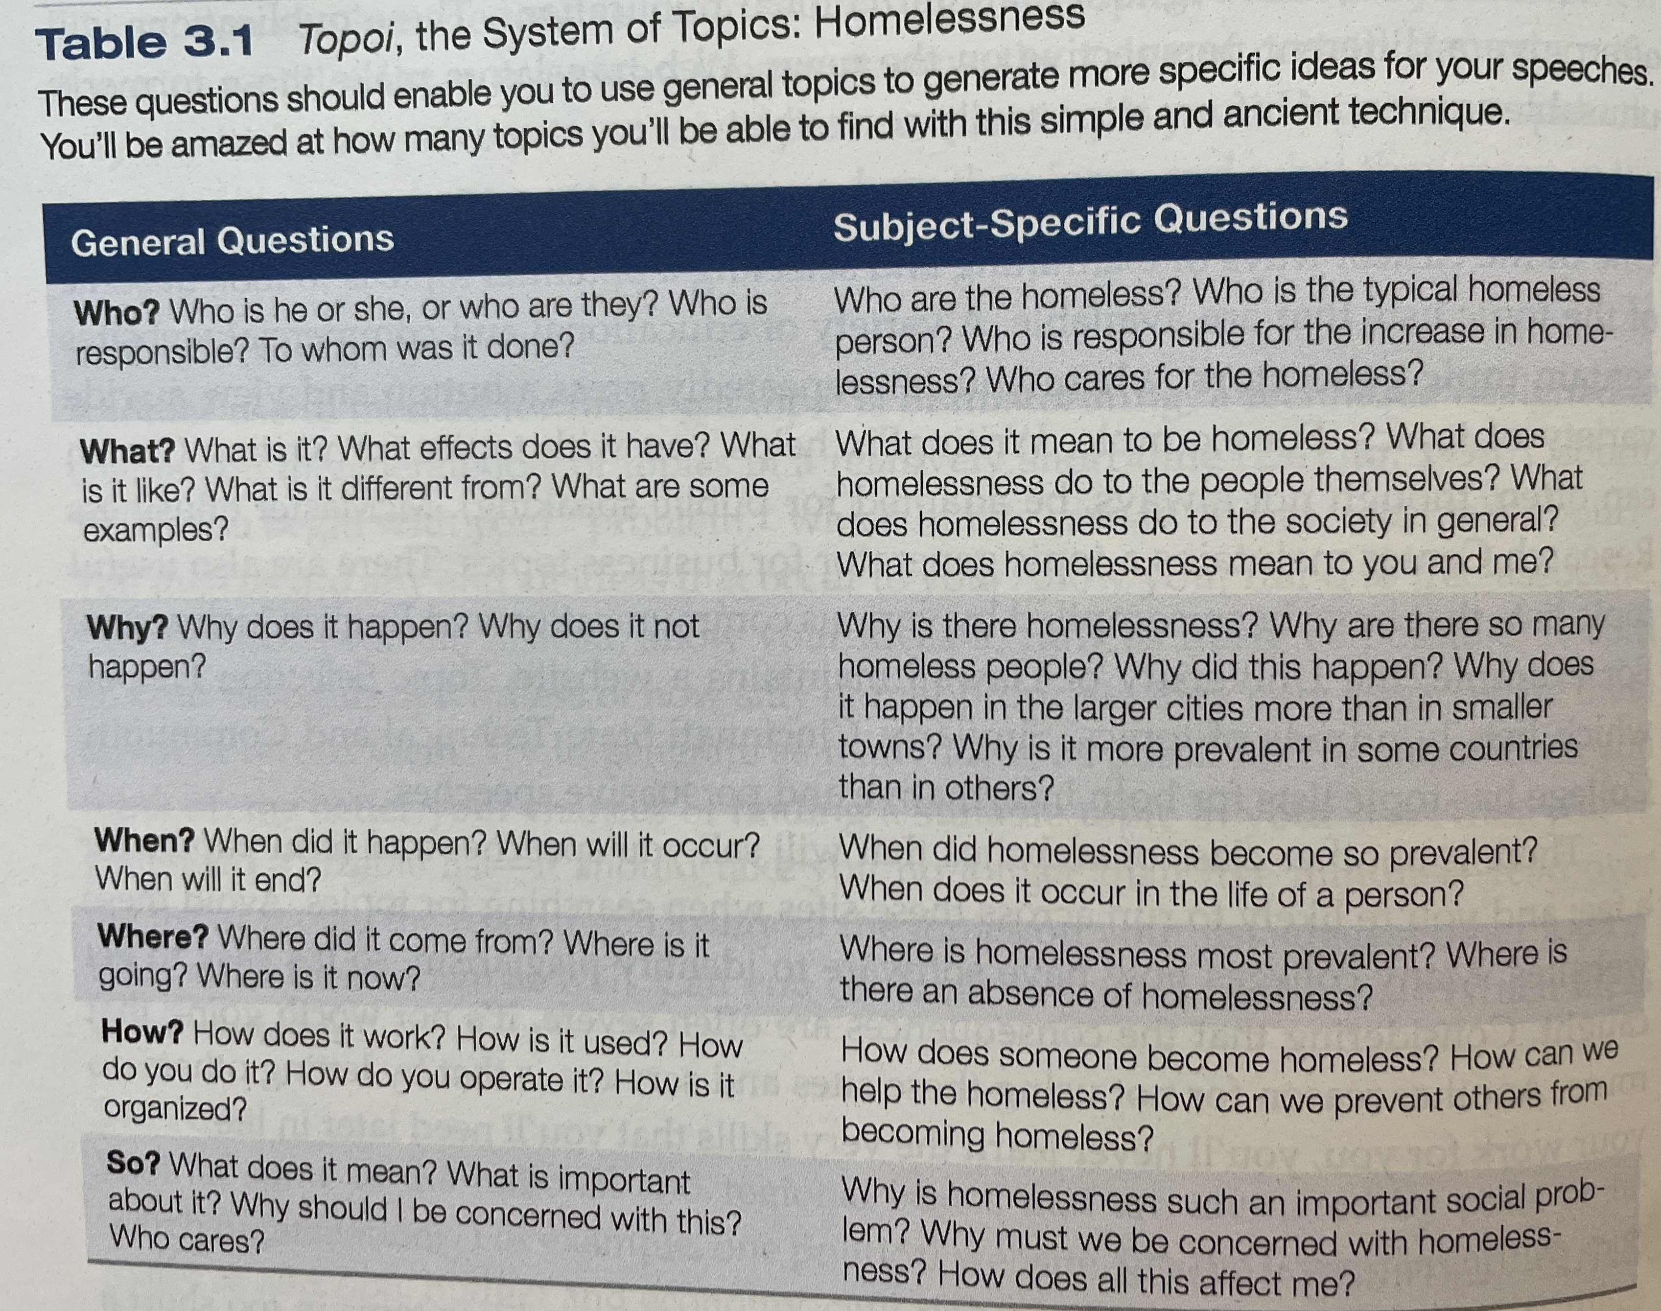
Topoi

Slide 6
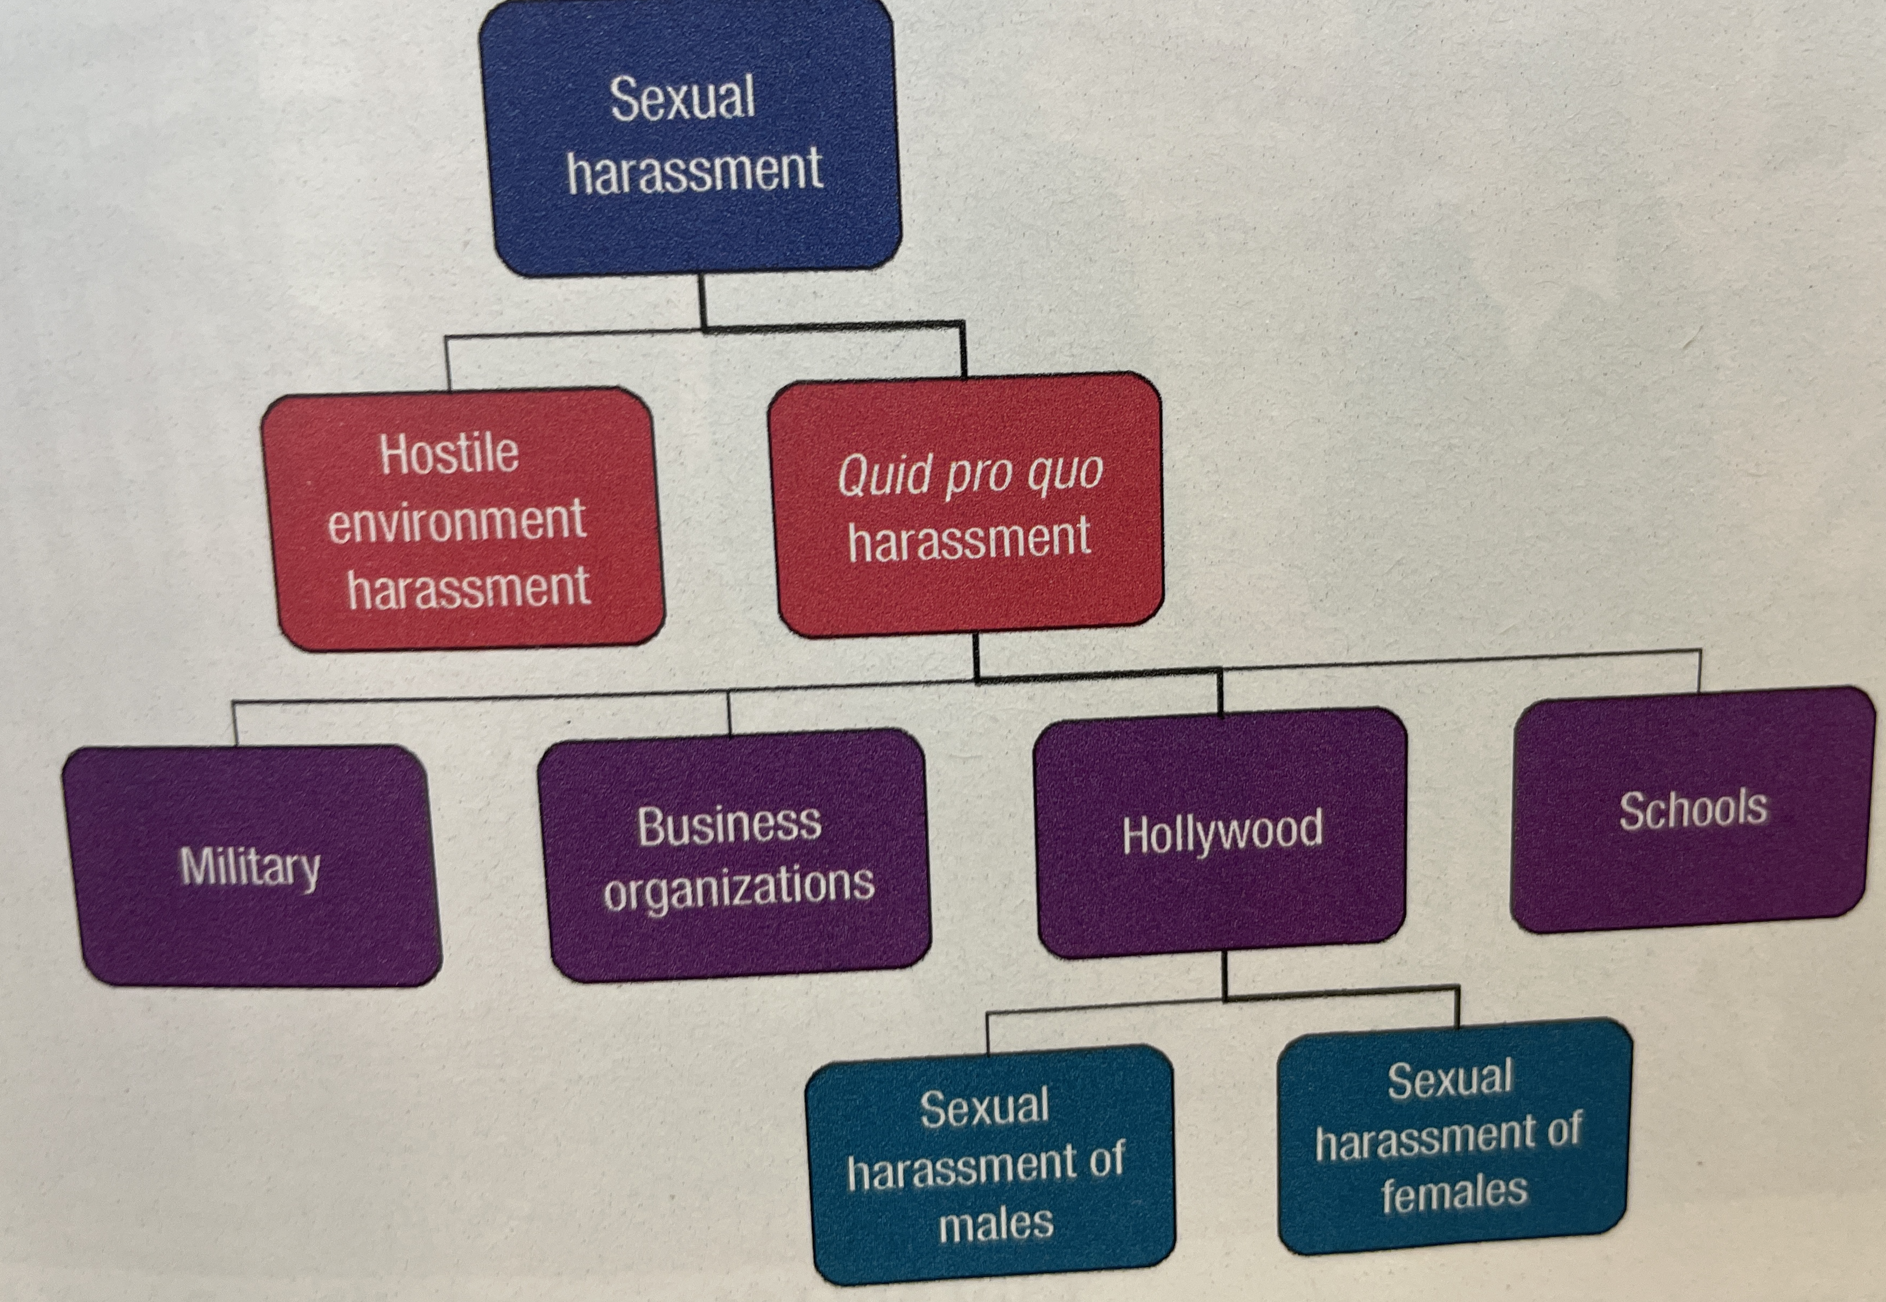
Tree Diagrams

Slide 7
Purpose Statement
General Purpose- To inform, to persuade, to introduce, to say farewell
Specific purpose
To inform my audience about the tax laws of crypto currency.

Slide 8
Thesis Statements
Thesis- central idea, theme, essence of your speech
Needs to contain the contents of the speech in one sentence
Ex. Physician-assisted suicide is morally justifiable, and should be universally legalized, because it relieves the suffering of those in pain.
This includes your main points
Physician-assisted suicide is morally justifiable
Physician-assisted suicide should be universally legalized
Physician-assisted suicide relieves the suffering of those in pain
Notes:
This also helps develop parrel wording

Slide 9
Summary
Lets generate our own possible topics and thesis statements now in groups.

